Slide 1
Identification of Disinformation types in LLMs
2 September
Bhavana Ramesh
Durwankur Gursale
Abram Jopaul

Slide 2
Problem Statement
Introduction
Models
Agenda
Roadmap
Datasets and List of subreddits
Observations
Summary

Slide 3
Problem Statement
RQ1: How efficiently various LLM models label the category of disinformation over simple and structured prompts ?
RQ2: Does accuracy depend on position of the categories? Which is the most deceptive disinformation category ?
RQ3: Predictions of SLMs v/s LLMs. Can SLMs outperform LLMs with appropriate dataset ?

Slide 4
Introduction
Disinformation v/s Misinformation
Types of disinformation : Satire, False Connection, Misleading, Imposter, Manipulated and Fabricated.
Need to categorize.
Importance of prompting technique.

Slide 5
Kickstart
Defining research questions and methodology
Creating Dataset
Dataset creation based on Fakeddit data
Prompting Techniques
Experimenting on various prompts
Model Selection and text classification
Model selection and fine tuning
Evaluation
Evaluation of the results
Conclusion
Concluding the observations

Slide 6
Dataset
Fakeddit Dataset
Multimodal fake news dataset consisting of over 1 million samples - Nakamura, K., Levy, S., & Wang, W. Y. (2019). r/fakeddit: A new multimodal benchmark dataset for fine-grained fake news detection.
Classifying data into 6 categories : True, Satire, Misleading, Imposter, False Connection and Manipulated Content.
Not appropriate for our application as
It is more focused on Multimodal data - text, image, metadata, and comments data.
False connection and Manipulated content focuses more on images.
However, subreddits are made used as sources.

Slide 7
List of subreddits used in Dataset
Subreddit | Category | URL
neutralnews | True | https://www.reddit.com/r/neutralnews
upliftingnews | True | https://www.reddit.com/r/upliftingnews
usnews | True | https://www.reddit.com/r/usnews
theonion | Satire | https://www.reddit.com/r/theonion
waterfordwhispersnews | Satire | https://www.reddit.com/r/waterfordwhispersnews
savedyouaclick | Misleading | https://www.reddit.com/r/savedyouaclick
subredditsimulator | Imposter | https://www.reddit.com/r/subredditsimulator
subsimulatorgpt2 | Imposter | https://www.reddit.com/r/subsimulatorgpt2

Slide 8
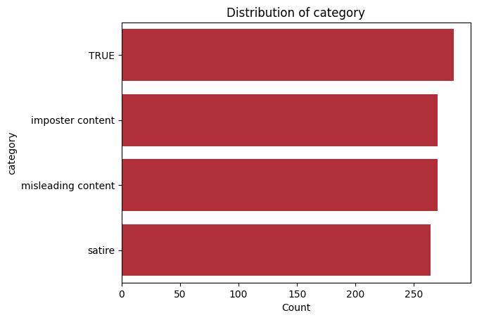
Data Collection
PullPush API - Service for the indexing and retrieval of content that Reddit users have submitted to Reddit.
Python libraries like BeautifulSoup, Newspaper3k used for web scraping.
Quality Assurance
Each subreddit has moderators that ensure submissions pertain to the subreddit theme.
Filtered out submissions that had a upvote ratio of less than 1 to further ensure that the collected data is credible.

Slide 9
Models
SLM
RoBERTa
LLM
Llama-3-8B-Instruct
Gemma-2-9b-it
Mistral-7B-Instruct-v0.3

Slide 10
Types of Disinformation
True : True content is accurate in accordance with fact.
Satire/Parody : This category consists of content that spins true contemporary content with a satirical tone or information that makes it false.
Misleading Content: This category consists of information that is intentionally manipulated to fool the audience.
Imposter Content : This category contains bot-generated content.

Slide 11
Prompting Methods
Zero Shot Prompting
Chain of Thoughts
Few Shot Prompting

Slide 12
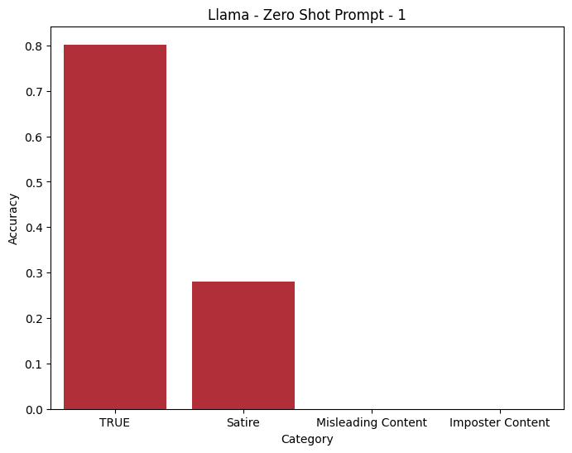
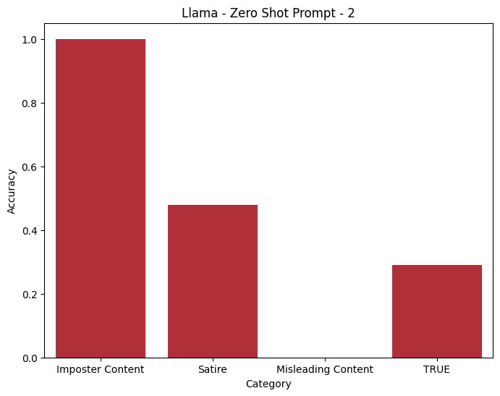
Zero Shot Prompting
Prompt -1 (Llama)
Content categories are as follows:
True
Satire
Imposter Content
Misleading Content
Analyze the type of content and return the corresponding label.
Prompt -2 (Llama)
Content categories are as follows:
Imposter Content
Satire
Misleading Content
True
Analyze the type of content and return the corresponding label.

Slide 13
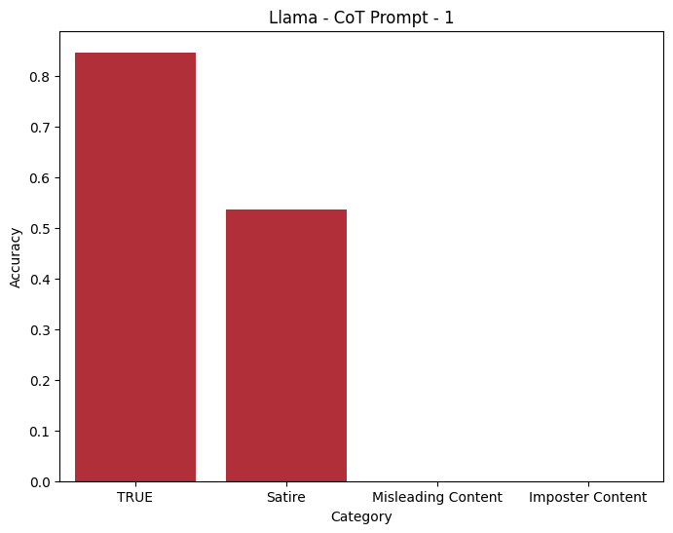
Chain of Thoughts Prompting
General Prompt
Analyze the type of the content enclosed in square brackets, and determine if it is true content, satire, misleading content, or imposter content. Explain your reasoning step by step and then return the answer as the corresponding content label "true content" or "satire" or "misleading content" or "imposter content".
Step-by-step reasoning:
1. Identify the primary purpose of the content (inform, entertain, deceive, etc.).
2. Check for factual accuracy and sources.
3. Determine if there is any exaggeration, humor, or irony.
4. Check for any signs of manipulation or alteration.
5. Determine if the content has been entirely fabricated.

Slide 14
Positional Bias

Slide 15
Positional Bias
Refers to the tendency of transformer based models to favor certain positions within the input text when generating or interpreting information
LLMs inherently store positional information within their hidden states, affecting the model's attention weights and causing position bias -[Yu, Yijiong, et al.]
24 Permutations Test
For each model perform zero shot with every other order combinations of the categories.
We have 4 labels and 4 positions, P(4, 4) = 4! = 4×3×2×1 = 24

Slide 16
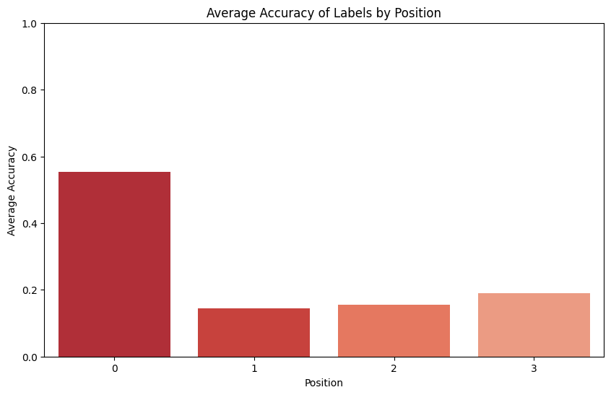
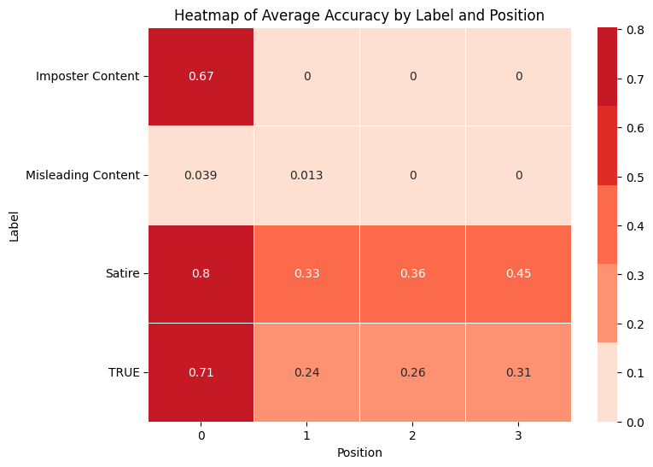
Positional Bias - Llama
Evaluating all the 24 permutations of 4 labels - Llama-3-8B-Instruct-24-permutations

Slide 17
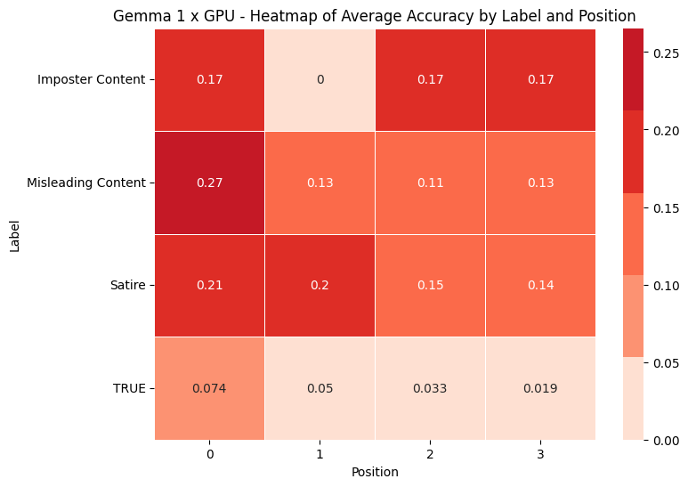
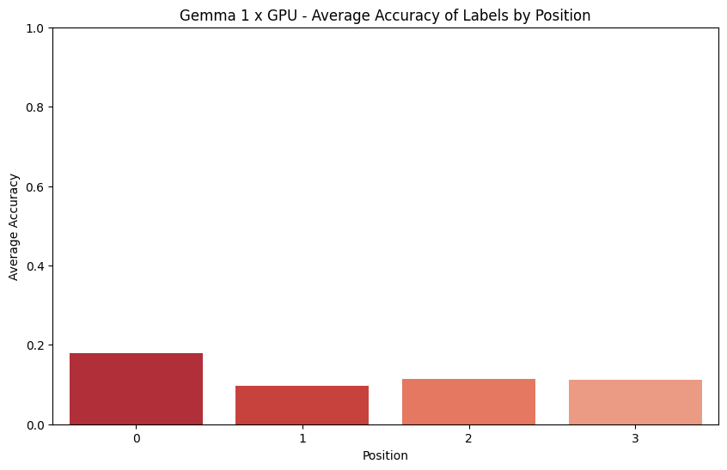
Positional Bias - Gemma in Single GPU
Less accuracy compared to Llama ( Gemma 9B vs Llama 8B)
Not having sufficient GPU power
Gemma-2-9b-it-24-permutations

Slide 18
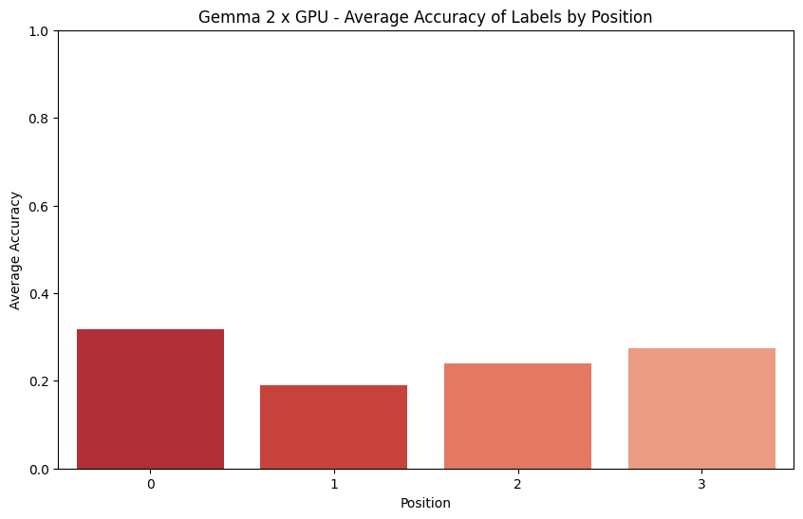
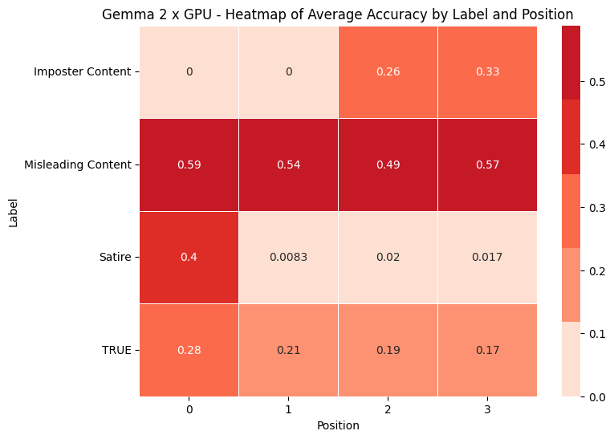
Positional Bias - Gemma in 2 GPUs
Increase in Accuracy as GPU power increases.

Slide 19
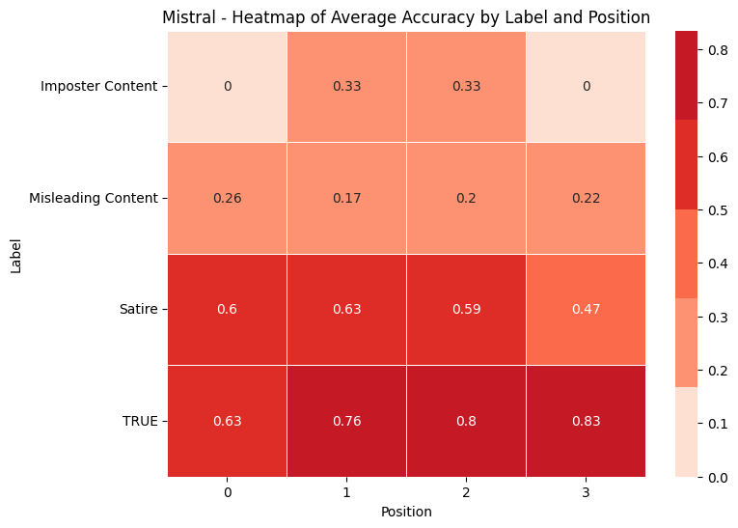
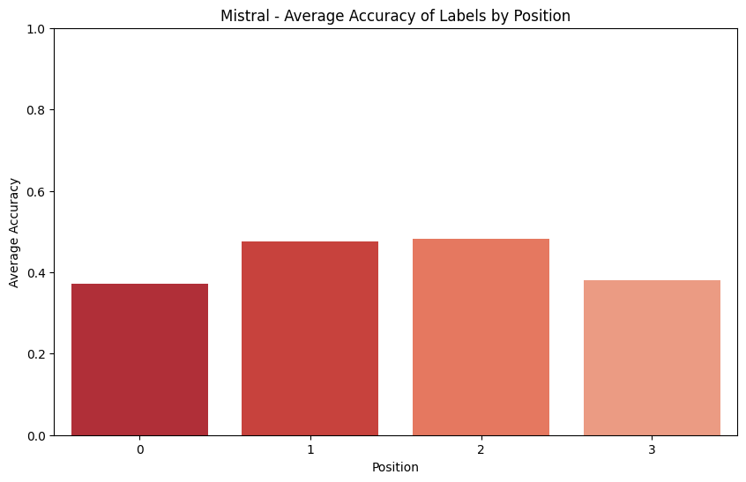
Positional Bias - Mistral
Less positional biased compared to Llama and Gemma
Less time and more GPU efficient

Slide 20
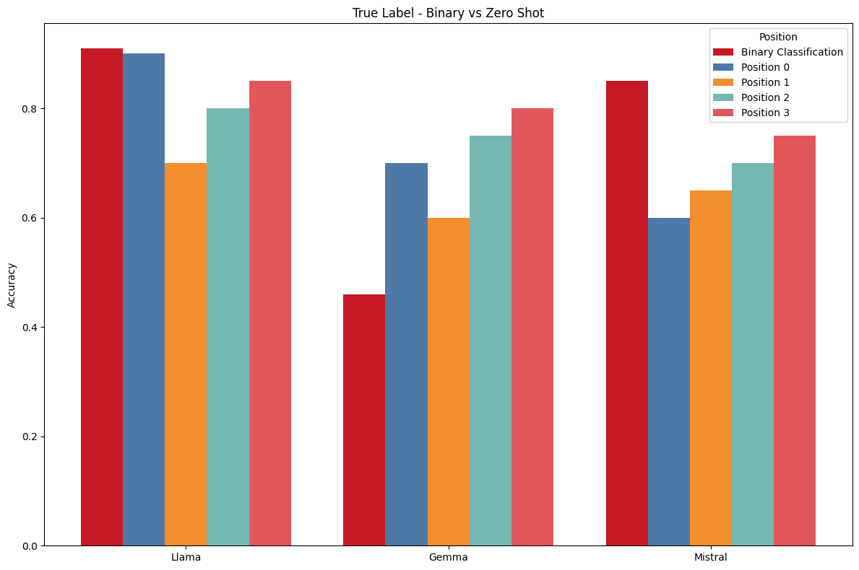
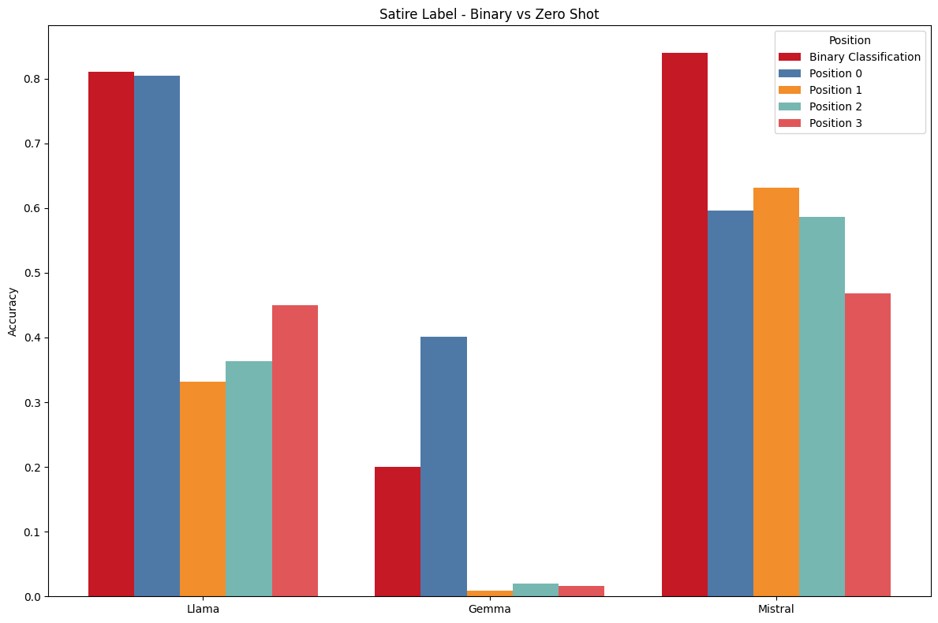
Binary Classification

Slide 21
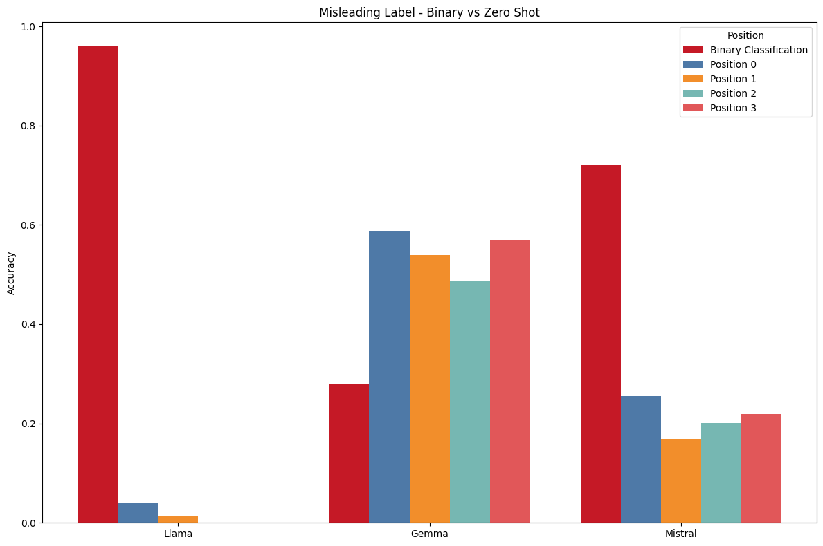
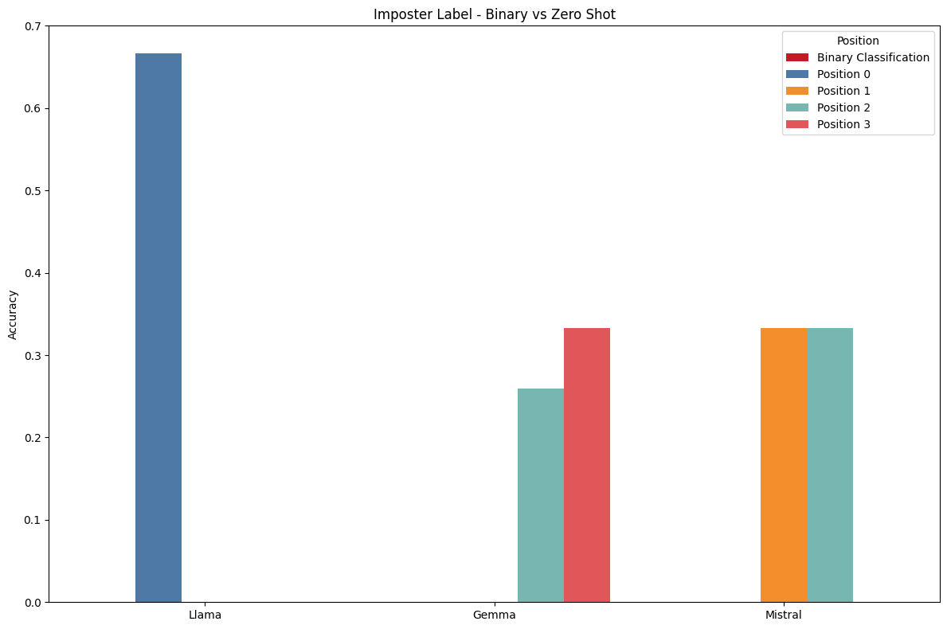
Binary Classification

Slide 22
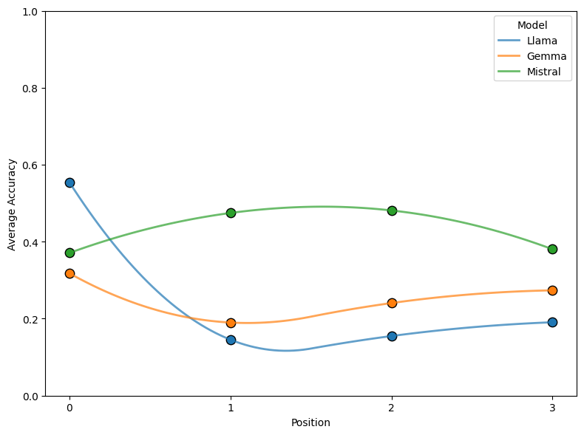
Attention Bias

Slide 23
Attention Bias
Attention Bias in LLMs: Reason and Supporting Research
U-Shaped Attention Bias - [Hsieh, Cheng-Yu] - Study highlighted a U-shaped attention pattern where LLMs assign higher attention weights to tokens at the beginning and end of a sequence, which can lead to a bias towards the first document or label regardless of its relevance.
Found in the middle - LLM’s struggle to capture relevant information located in the middle of their input even though when they are trained with large dataset.
Possible Solution: To rerank the labels based on relevance.

Slide 24
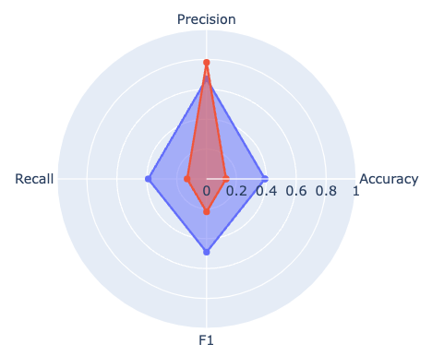
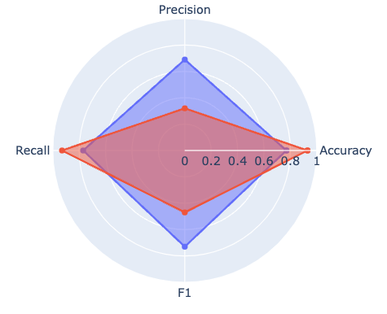
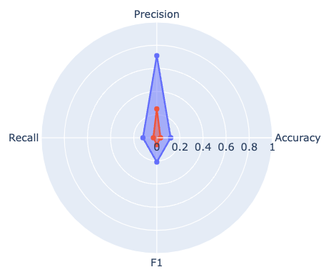
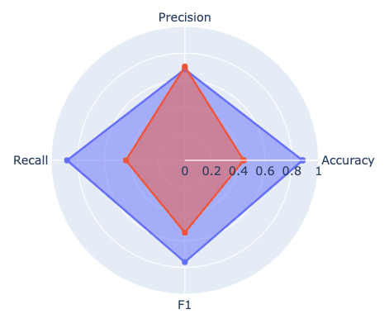
Efficient Prompting Technique ( Few Shot )
True
Satire
Llama
Mistral
Misleading
Imposter

Slide 25
SLM vs LLM
RoBERTa managed to provide a accuracy of 23% with the dataset of 500 rows and 30% with the dataset of 1000 rows ( With fine-tuning ).
Whereas LLMs like Llama gave accuracy of 53% with Few shot and Mistral gave accuracy of 40% with CoT prompting technique ( Without fine-tuning ).
Therefore, it’s clear that SLM couldn’t outperform LLM with more or less the same approach but surprisingly a spike in accuracy wrt Roberta is seen as the size of dataset increases.

Slide 26
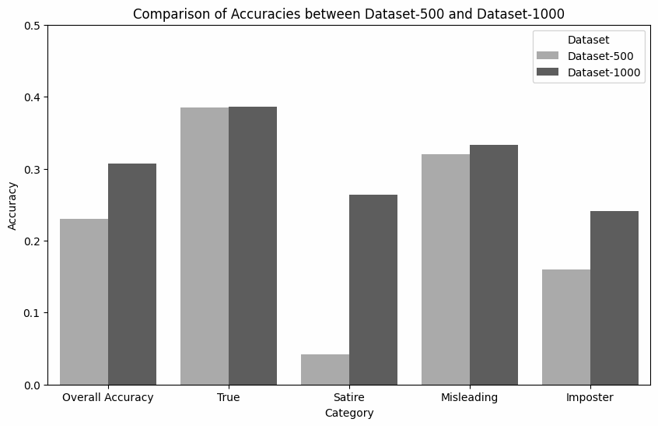
Fine tuning comparison on 500 vs 1000 datasets
Model: Roberta

Slide 27
Summary
SLM couldn’t outperform LLM. However, fine-tuning with larger datasets can improve the accuracy.
Few Shot prompting performs well across various models giving equal weightage to all labels.
Attention bias can be U-shaped or Found-in-the-middle.
Solution is to rerank the categories based on the relevance or the difficulty LLMs face to categorise the labels.
The most deceptive disinformation category is Imposter content due to sophisticated mimicry of true content.

Slide 28
Prompting Methods
Llama :
Zero Shot Prompting | Chain of Thoughts | Few Shot prompting
Prompt Used: Link - Zero Shot Prompt | Prompt Used: Link - CoT Prompt | Prompt Used: Link - Few Shot Prompt
Accuracy - 47% | Accuracy - 35.2% | Accuracy - 53%
Label Bias - satire, misleading | Label Bias - true, satire | Label Bias - Mostly equal weightage.

Slide 29
Zero Shot Prompting | Chain of Thoughts | Few Shot prompting
Prompt Used: Link - Zero Shot Prompt | Prompt Used: Link - CoT Prompt | Prompt Used: Link - Few Shot Prompt
Accuracy - 38.5% | Accuracy - 40% | Accuracy - 38.5%
Label Bias - true, satire, misleading | Label Bias - true, satire, misleading | Label Bias - Mostly equal weightage.
Mistral :

Slide 30
References
Nakamura, K., Levy, S., & Wang, W. Y. (2019).
Yu, Yijiong - Mitigate Positional Bias in Large Language Models via Scaling a Single Dimension.
Hsieh, Cheng-Yu - Found in the Middle: Calibrating positional Attention Bias Improves Long Context Utilization.
Disinformation and 7 common forms of Information Disorder
SLMv/sLLM

Slide 31
Thank you

